Slide 1
A holistic scheduler framework to manage xPUs for containers
Huawei OS Kernel Lab: Meskhidze Konstantin/Chenhui

Slide 2
Agenda
Problem statement
Xsched framework overall description
Model selection
Ascend computation workflow
Stream model
Stream model drawback
Context model
Xsched class description
“Completely fair scheduler” class
“Real time” class
Bandwidth control
Relative control with Shares
Absolute control with Quotas
Future Plans
Relative Shares
Absolute Quotas

Slide 3
Problem statement
Background
The rapid development of AI services increases computing power requirements. Insufficient computing power and high computing cost restrict the development of AI technologies. However, the current XPU computing power cannot be fully utilized, low computing power utilization aggravates this pain point.
Computing power is varied. Different hardware types - GPU, NPU, and TPU. Technology stacks are siloed, ecosystem are fragmented, high maintenance costs, and computing power cannot be reused.
The resource usage is low due to pool-based deployment and resource reservation.
Time domain
the GPU usage on the public cloud is only 20% to 30%.
GPU exclusive use leads to low resource utilization.
Technical issues:
Exclusive computing power.
Static computing power control.
Lack of unified abstraction and management.
Space
SM3
SM2
SM1
SM0
Time
Solution: Unified scheduling framework and computing power ecosystem.
optimize the siloed AI technological stack.
improve dynamic and flexible computing power management
leverage computing power efficiency for different service scenarios.
the average GPU usage of a single task is <20%.

Slide 4
Xsched framework overall description
Key features:
fast task preemption in kernel.
low latency and overhead.
modular nature, scheduling policy easy integration.
QoS management and control with cgroups.
K8S
NODE
Container 1
Container 2
start
AI inference APP
AI training APP
Container Agent
MindSpore/Pytorch
MindSpore/Pytorch
Bandwidth control
CANN
CANN
User1
User2
config
User
Container 1
Container 2
Kernel
30% NPU computing power
40% NPU computing power
cgroup
Xsched framework
A
B
C
D
control
Core API
Preemption
logic
Task selection logic
Group scheduling
Scheduling policy
Bandwidth control
A
B
C
D
Ascend NPU
Ascend NPU

Slide 5
Model selection

Slide 6
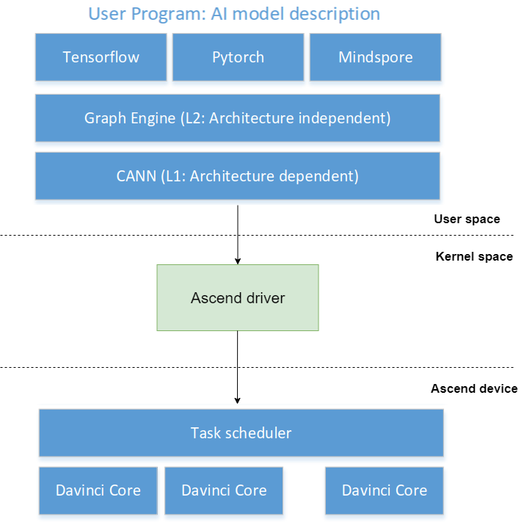
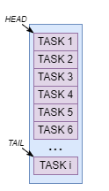
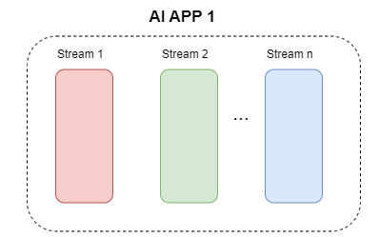
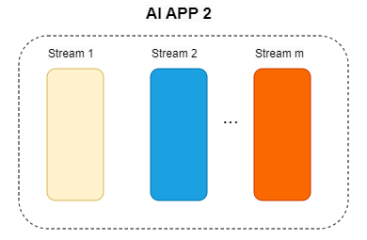
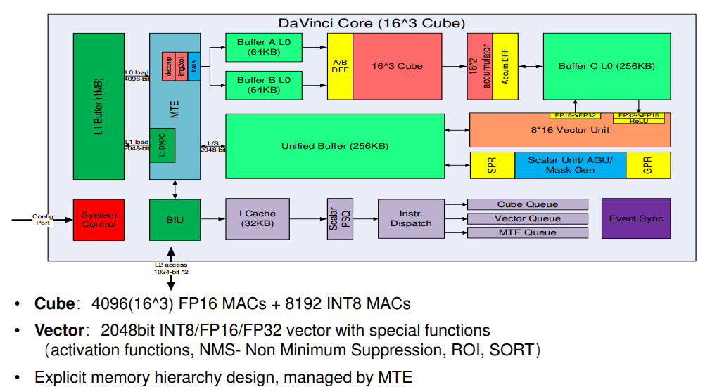
Ascend computation workflow

Slide 7
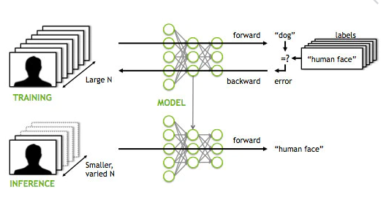
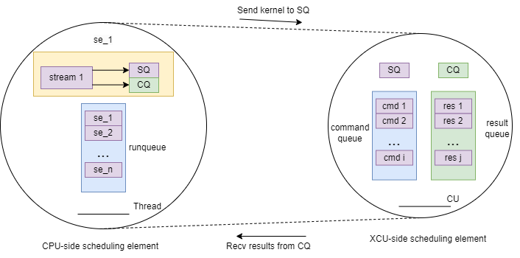
Stream model
Low-level instructions stream is a scheduling object.
A scheduling entity (se) - controls the running of stream. One se per stream.
A kernel thread represents one computing unit CU.
Stream : SQ/CQ = 1:1 model (Linux-like thread model).
Split tasks into 2 categories:
inference tasks (delay-sensitive). Higher priority.
training tasks.

Slide 8
Stream model drawback
Task execution is serial within a stream, between streams is concurrent.
Possible dependencies between streams.
Dependencies are controlled by commands: EventRecord and EventWait.
Dependency can cause a DEADLOCK, when Stream2 is scheduled first.

Slide 9
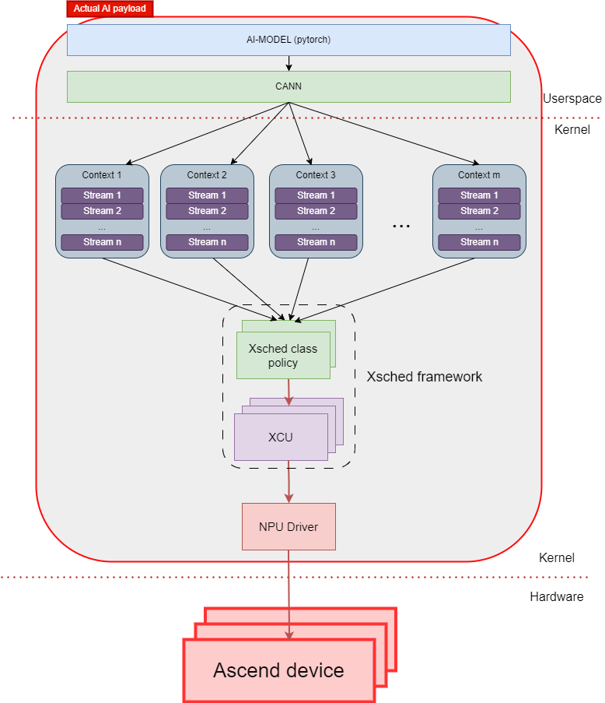
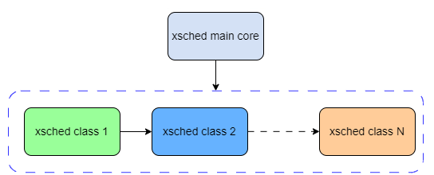
Context model
Context is a scheduling object.
Context can include several streams.
One Ascend device (NPU) corresponds to a computing power unit (XCU). At least one kthread per XCU to maintain scheduling.
Modular design, inherited from Linux scheduler:
Per XCU runqueue.

Slide 10
Xsched class description

Slide 11
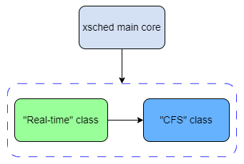
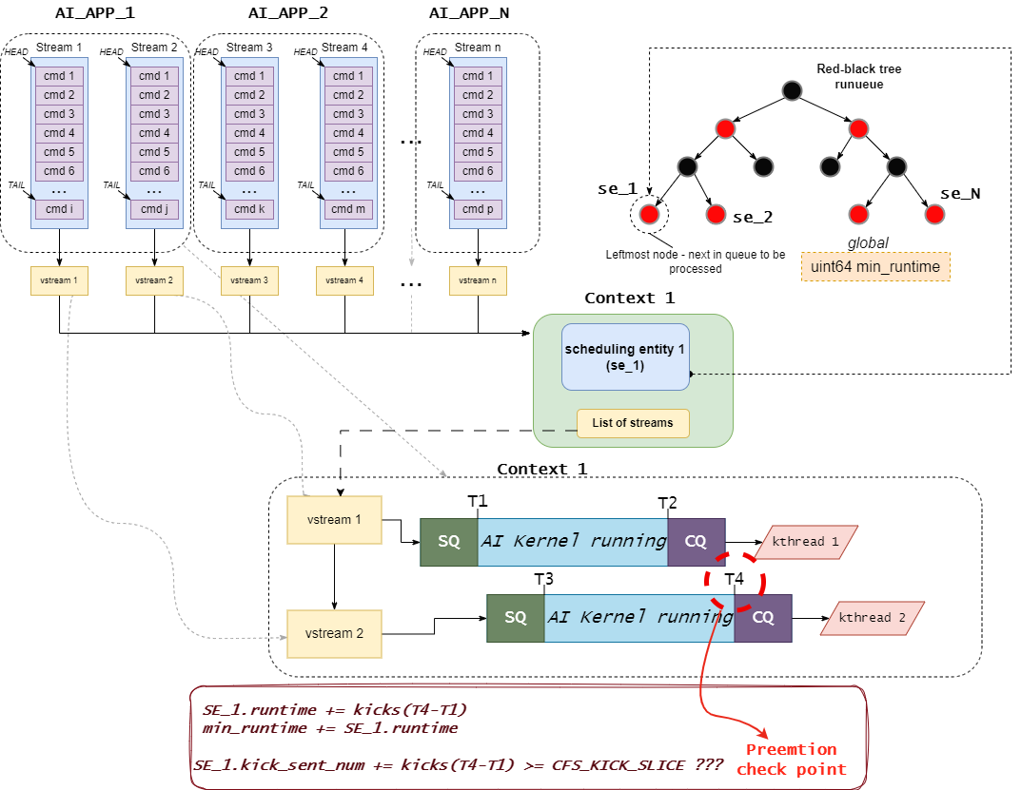
“Completely fair scheduler” class
Serves AI training tasks.
Runqueue is a red-black tree.
runtime - a kicks number (commands submitted to XCU) between T1 (first stream to submit) and T4 (last stream to finish).
Leftmost elemet (min runtime) is always picked to run.
At least one kernel kthread maintains the scheduling process.
Fixed CFS_KICK_SLICE.
T4 – is a preemption check point.
Context preemption:
High priority context has streams to run (in RT class).
CFS_KICK_SLICE is expired.

Slide 12
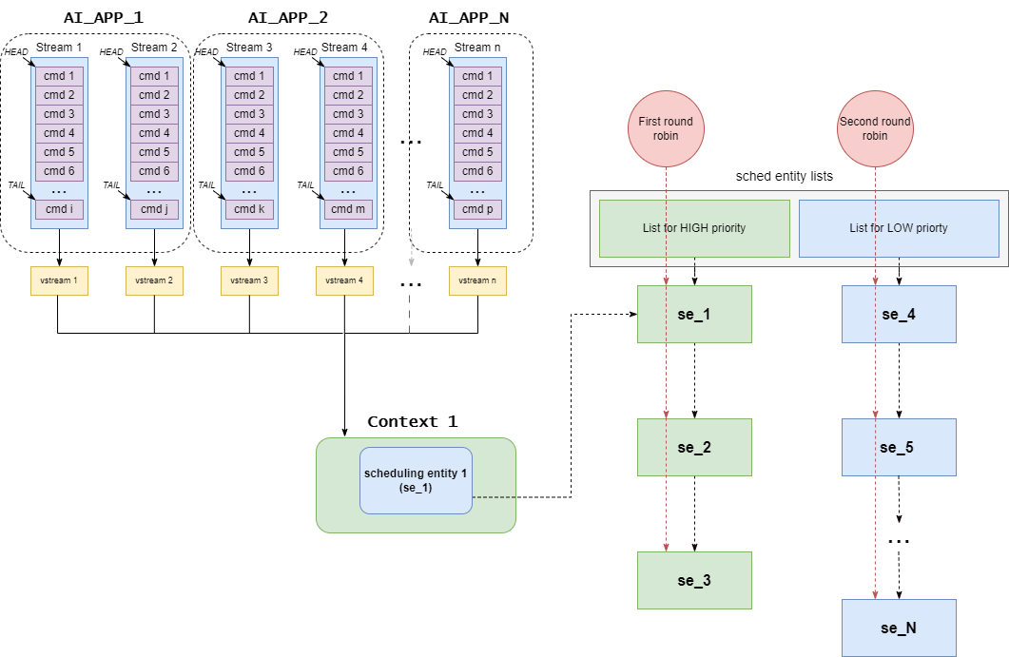
“Real-Time” class
Serves AI inference tasks.
Runqueue – two linked lists (high priority or low priority)
RT class’s mechanism runs a Round Robin on both lists.
Context preemption::
High priority context has streams to run.
RT_KICK_SLICE is expired.

Slide 13
Bandwidth control

Slide 14
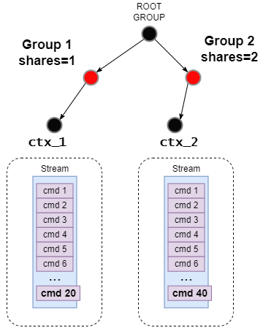
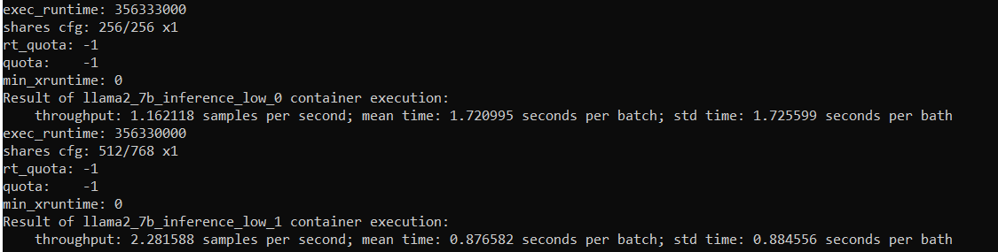
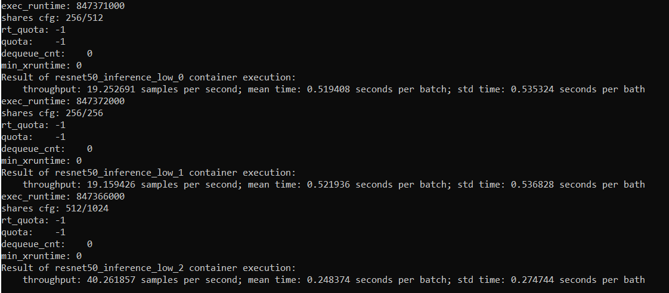
Relative control with Shares
> mkdir /sys/fs/cgroup/llama # create cgroup > echo 256 >> /sys/fs/cgroup/llama/xcu.shares # assign share to 256 … > echo pid_llama >> /sys/fs/cgroup/llama_256/cgroup.procs # add proccess to llama cgroup
> launch_llama_container.sh # start execution of container
llama2_inference, 2 containers, Shares - 256/512. Throughput – 1.16/2.28 samples per/sec.
Resnet50_inference, 3 containers, Shares - 256/256/512. Throughput - 19.25/19.15/40.26 samples per/sec.
Shares allow to rearrange streams bandwidth
ratio between applications.
In cloud scenarios a user who pays more gets more bandwidth.

Slide 15
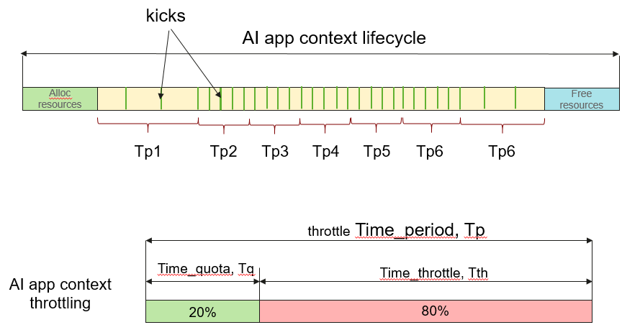
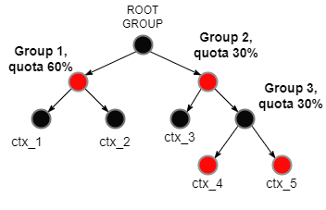
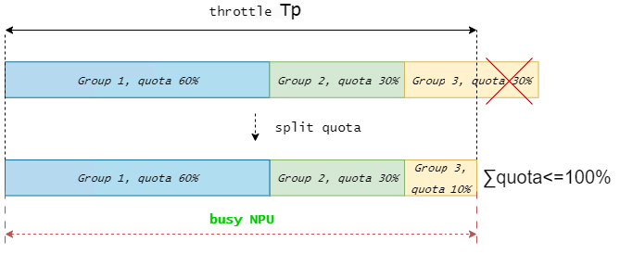
Absolute control with Quotas
Measure commands (kicks) frequency in the system.
Calculate throttling time period.
Throttle contexts based on their quotas.
pros: max NPU utilization (in time).
cons: limited number quota groups (possible just one with 100% quota).
Quotas give absolute control of application’s bandwidth.

Slide 16
Future plans
Open source plan:
OpenEuler SP23.09 in Dec 2024.
Follow-up development plan:
Hybrid deployment - scheduling, memory, and I/O collaboration, implementing QoS management and control.
Large-scale model scenarios, multi-NPU collaborative preemption, load balancing and bandwidth control.

Slide 17
THANKS

